Slide 1
Thomas Janssen – 24 November 2020
Micronaut 2

Slide 2

Micronaut 2.1
Introduction
Getting started
Running it
Configuration
Extending
Hands-on!
Recap
Questions

Slide 3

Introduction

Slide 4
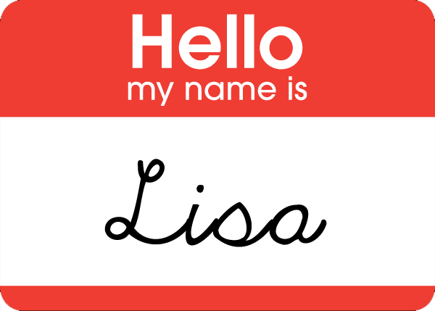
Introduction – Short Introductionary Round

Slide 5
Introduction - Micronaut
"A modern, JVM-based, full-stack framework for building modular, easily testable microservice and serverless applications."
https://micronaut.io/

Slide 6

Introduction - Micronaut
Fullstack, Fat-Jar, Java-EE/Jakarta
Fast startup time
Reduced memory footprint
Minimal use of reflection
Minimal use of proxies
No runtime bytecode generation
Easy Unit Testing

Slide 7
Introduction - Micronaut
Features:
Bean Injection
Minimal boilerplaiting and autoconfiguration
Modular extensions
Native Cloud Integration
Full* GraalVM Support

Slide 8
Introduction - Micronaut
Spring Boot, without reflection

Slide 9

Getting Started

Slide 10

Getting Started
Official:
Commandline utility
Launch site: https://micronaut.io/launch/
Unofficial:
Maven Archetypes and starters

Slide 11
Getting Started - Commandline
Get it at: https://micronaut.io/download.html
Or: Linux: sdk install micronaut Windows: choco install micronaut MacOS: brew cask install micronaut-projects/tap/micronaut

Slide 12
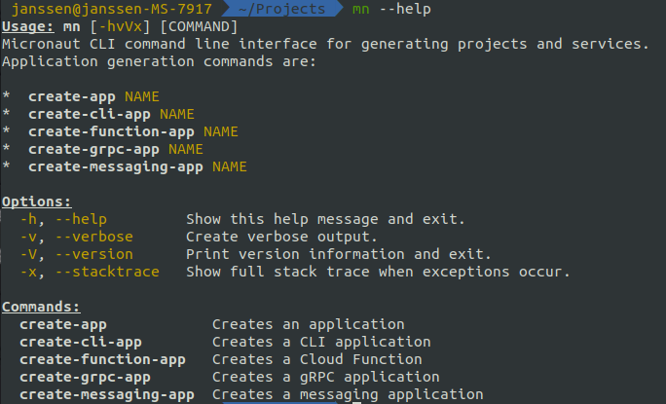
Getting Started - Commandline

Slide 13
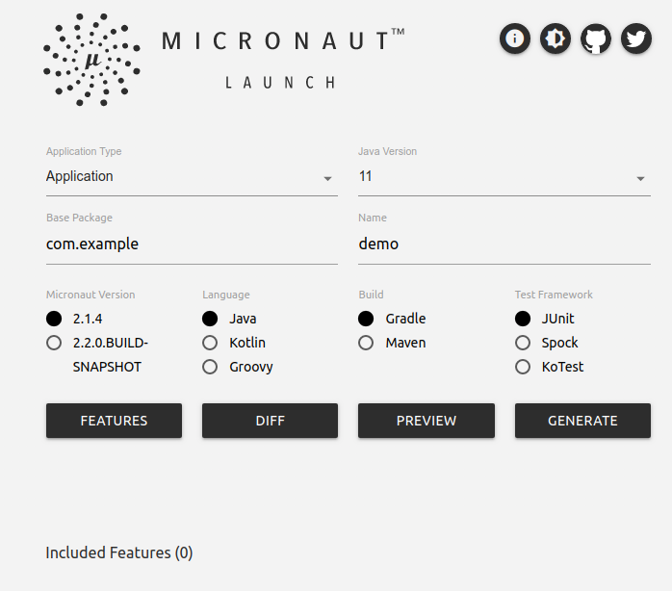
Getting Started - Launch
https://micronaut.io/launch/

Slide 14

Running It

Slide 15
Running It
java –jar MyApplication.java

Slide 16

Running it – From source
Default Gradle based
Maven options available if needed

Slide 17
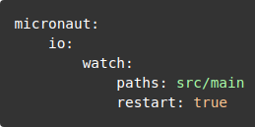
Running it – From source
Auto-restart on changes with Gradle. Add to application.yml:
$ /gradlew run --continuous

Slide 18

Running it - GraalVM
Gradle plugin available:
./gradlew nativeImage
Requires local GraalVM install

Slide 19

Configuration

Slide 20
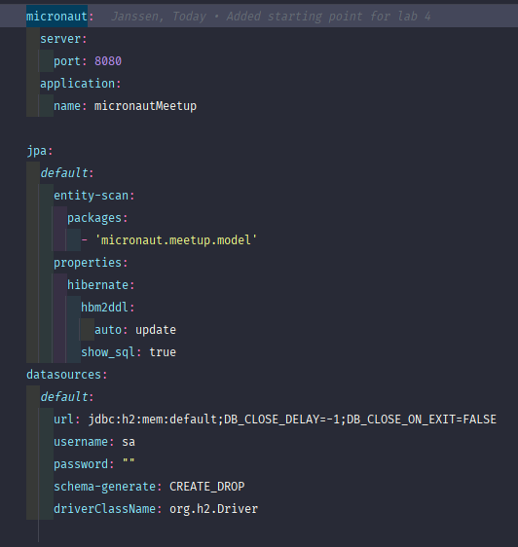
Configuration
Spring-like PropertySources
application.{properties/json/yml}
Autoconfiguration

Slide 21
Configuration – Property Injection
@Value("${my.property:default}") field injection
@Property(name = "my.property") field and argument injection
@ConfigurationProperties("my.prefix") class annotation for config classes
@EachProperty("my.prefix") class annotation for multiple configuration classes

Slide 22

Extending It

Slide 23
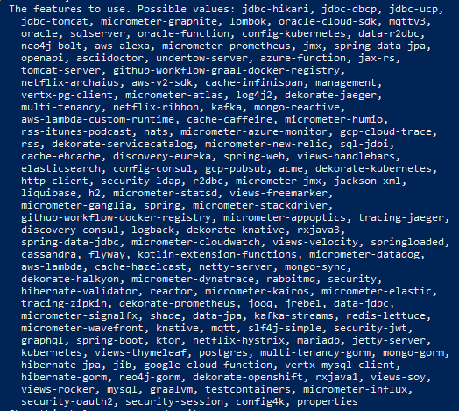
Extending – Third party support

Slide 24

Extending – To The Cloud
Spring Cloud
HashiCorp Consul
AWS
Oracle Cloud
Kubernetes
…

Slide 25

Extending – To the Cloud
Single dependency:
Service Discovery
ConfigMaps and Secrets
Health Checks
Example service.yml provided

Slide 26

Extending – To the Cloud
Sub-project Micronaut-AWS
$mn create-function-app my-app --features aws-lambda

Slide 27
Extending – How?
mn create-*-app features:
--features will allow you to add features and their dependencies on creation.
'features' are preset dependencies or subprojects
Running mn inside an existing project:
create-* will create basic beans, servers and clients for you with a tests class and dependencies.
Just a quick way of adding boilerplate code
Just add configufation to the application.yml!

Slide 28

Hands On!
https://github.com/terra10/codefest_micronaut
Create your own Rest API backed with a H2 database and Hibernate, and add some monitoring endpoints!

Slide 29
Hands On! - The Labs
Lab 0: Setting up your development environment
Lab 1: Creating your first Micronaut app with mn
Lab 2: Creating a webserver with custom endpoints
Lab 3: Adding a database
Lab 4: Adding monitoring endpoints
Lab 5: Working with Configuration
Lab 6: Advanced Bean Control

Slide 30
Hands On! – Extra Challange
Create a working GraalVM native image for all labs
Setup and connect to a Spring Boot Cloud Config Server

Slide 31
Hands On!
Have fun!

Slide 32

Hands-On – Closing comments

Slide 33
Questions?

